Slide 1
Lecture 11

Slide 2
Interface example
Iterator Interface example
Immutable Object
Comparable Class

Slide 3
Interface Example
Demo code is posted on iLearn in Lecture 11 folder.

Slide 4
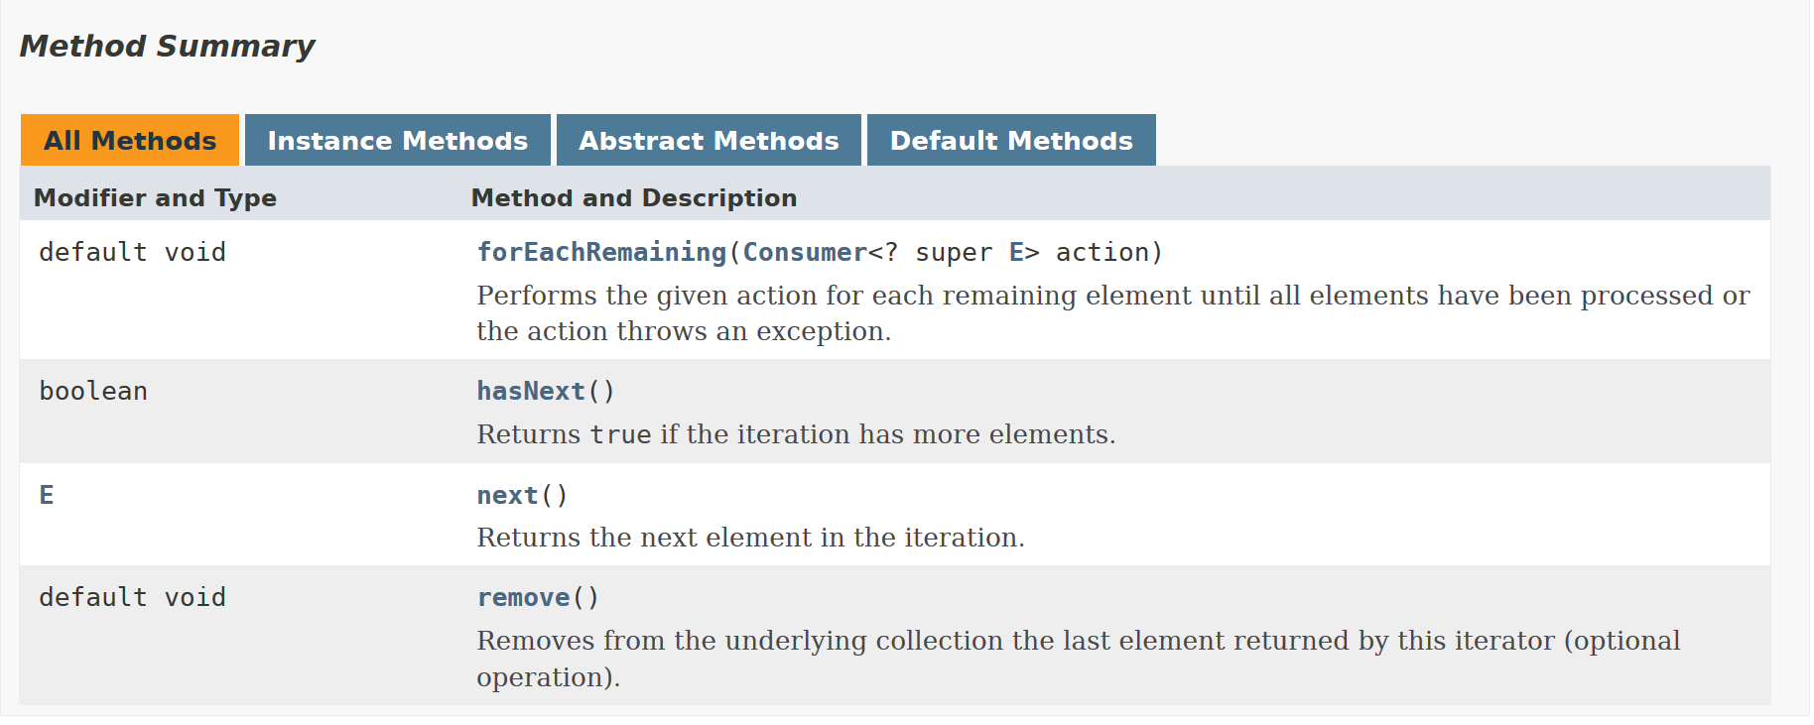
Iterator Interface
https://docs.oracle.com/javase/8/docs/api/java/util/Iterator.html

Slide 5
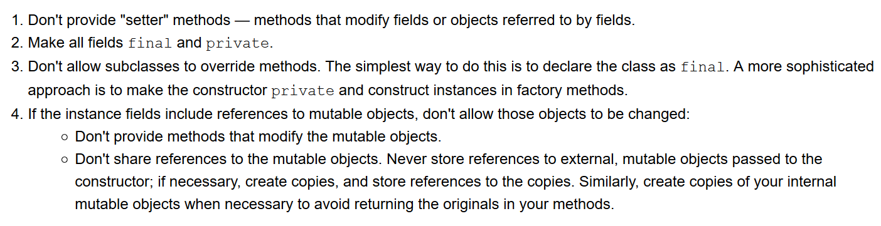
Immutable Object
Oracle Java Documentation
https://docs.oracle.com/javase/tutorial/essential/concurrency/imstrat.html

Slide 6
Comparable Class
Demo code is posted on iLearn in Lecture 11 folder.

